Slide 1
Stem cell
By Grace McLeod

Slide 2
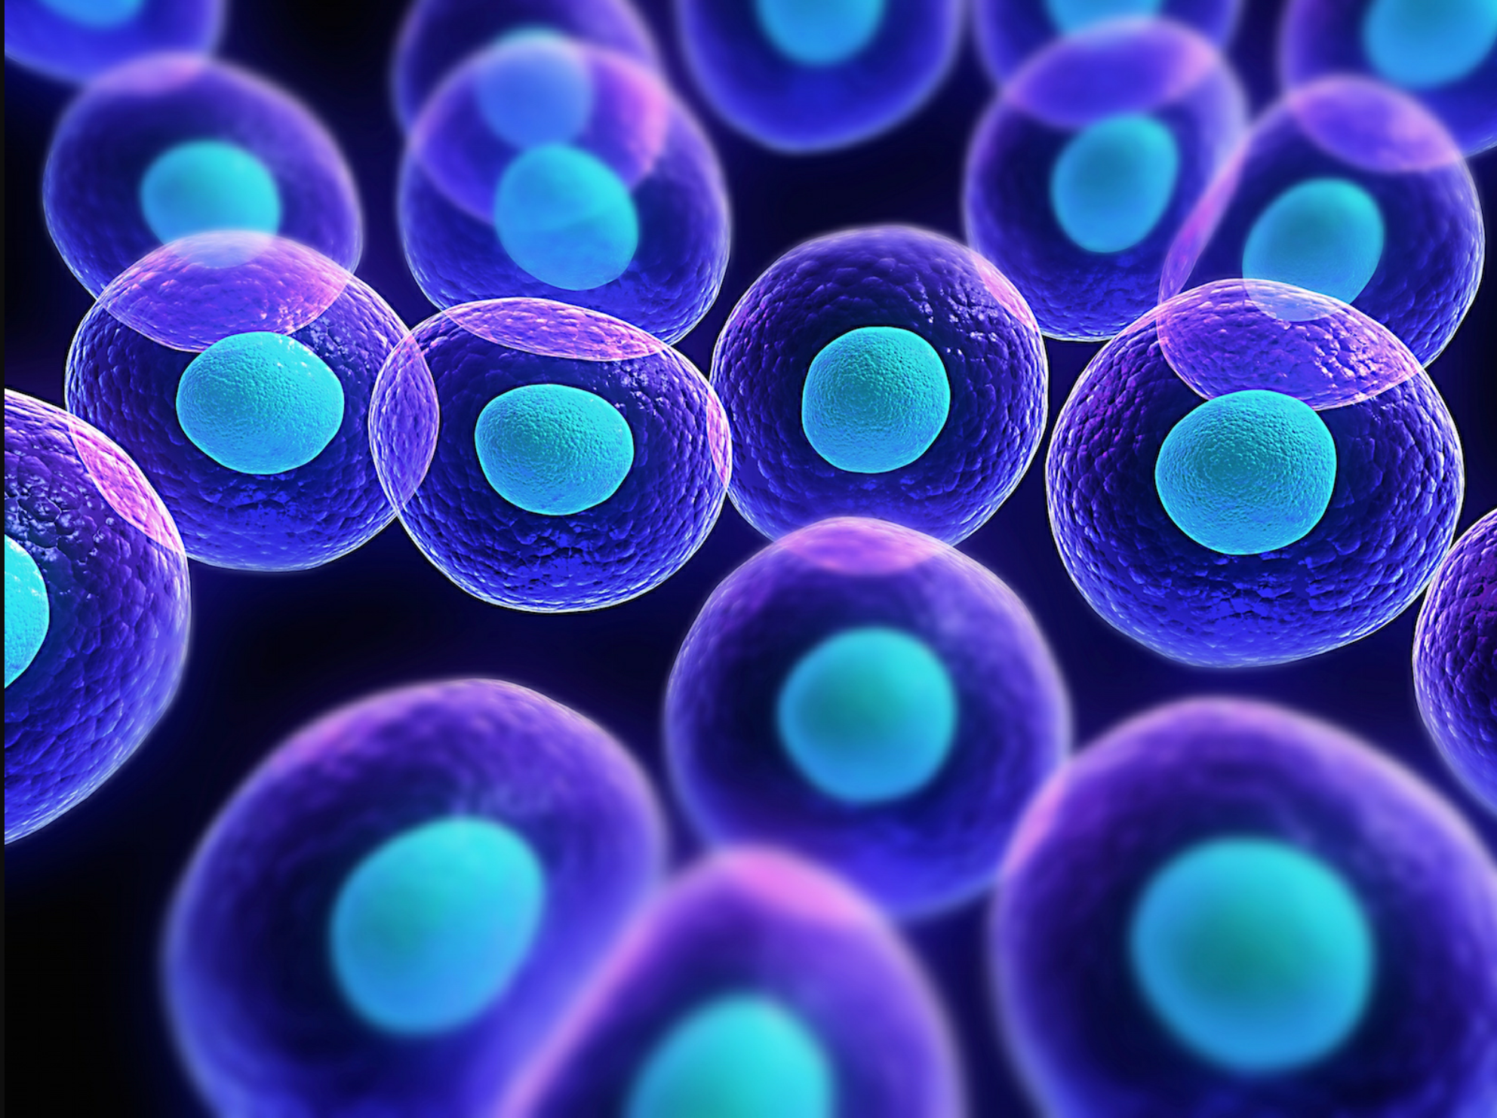
What are stem cells
Stem cells are undifferentiated. This means they’re can develop into cells that serve many different functions in different parts of the body.
most cells in your body are made up of differentiates cells. Stem cells are cells that haven’t differentiated yet. They have the ability to divide and make an indefinite number of copies of themselves.

Slide 3
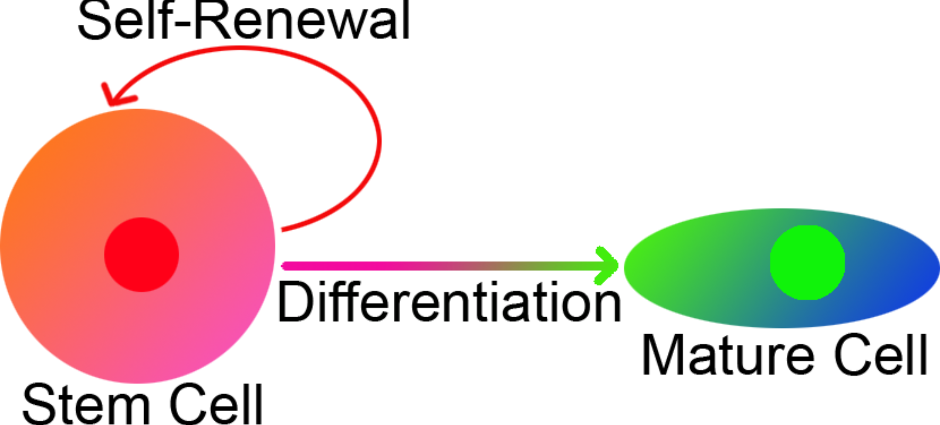
Different types of stem cells
Cord blood stem cells and amniotic fluid stem cells:
Cord blood stem cells are taken from the umbilical cord after childbirth. They can be frozen in cell banks for use in the future. This blood can successfully treat children with blood stream cancers. Stem cells have also been found in amniotic fluid. This is the fluid that surrounds a developing baby inside the mother’s womb.
Embryonic stem cells:
Embryonic stem cells come from human embryos that are three to five days old. They are taken during a process called in-vitro fertilization. This means that an egg is vertized in a lab not in the women’s stomach. Embryonic stem cells are known as pluripotent stem cells. These cells can give rise to basically any other type of cell in the body.
Adult stem cells:
These stem cells come from developed organs and tissues in the body. They are used from our bodies to repair and replace damaged tissue in the same area in which they are found.
Adult stem cells can’t differentiate into as many other types of cells as embryonic stem cells can.
(bone marrow transplants are a type of adult stem use)

Slide 4
Positives
- Cure problems that had occurred in body whether through blood or cells.
You can keep your umbilical cord to use in a potential crisis.
Can save a child’s or a person close to you‘s life
Adult stem cells can be reprogrammed and are less likely to be rejected when used in transplants.
Induced pluripotent stem cells help avoid issues of histocompatibility in transplants, and research on these cells will help reprogram diseased or damaged tissues.

Slide 5
Negatives
Embryonic stem cells may not be accepted when used in transplants because there is no way to generate them. They could potentially even cause tumors when used.
some people believe that it is important that we shouldn't mess with human life and God decides what's best for humans.
Some also believe that stem cell research will eventually make it possible to clone humans.

Slide 6
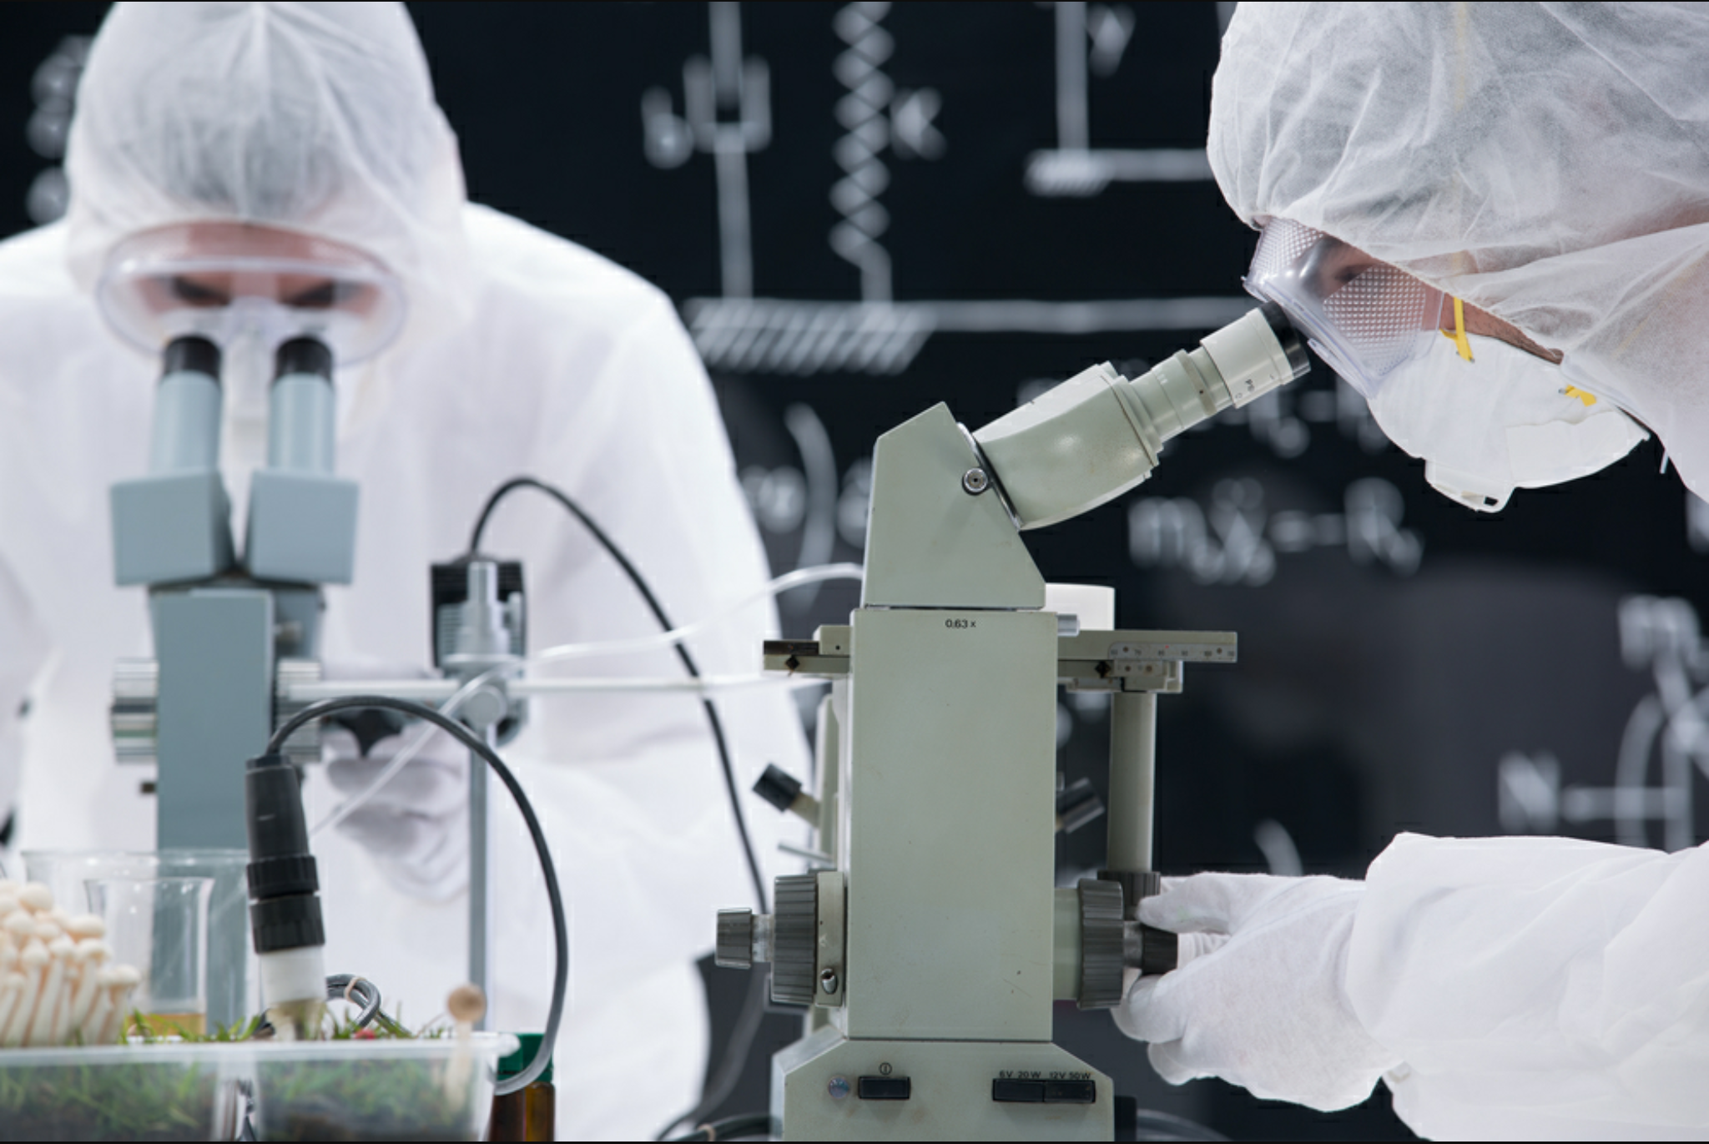
Future implications
Induced pluripotent stem cells:
A new type of stem cell research. They can differentiate into all types of specialized cells in the body. This means they can potentially produce new cells for any organ or tissue. The process of this stem cell is by de-differentiate the cells. This can possibly show the problem that had occurred. This will help prevent the immune system from rejecting an organ transplant.

Slide 7
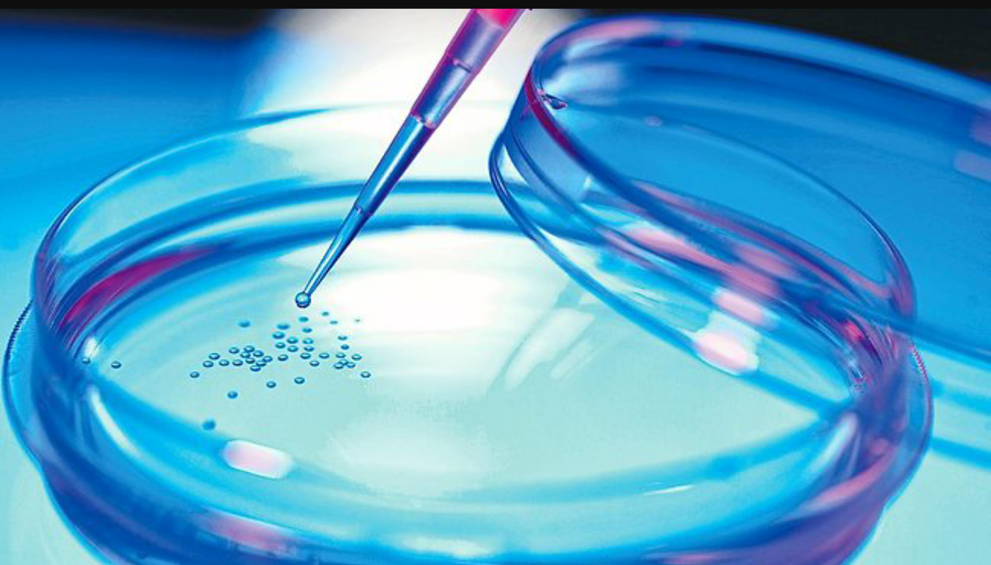
Ethical considerations
Embryonic stem cell research poses a moral dilemma. It forces us to pick between two moral principles:
The duty to prevent or alleviate suffering or The duty to respect the value of human life.

Slide 8
My opinion on stem cells research
My opinion on stem cell research is from a surgical sort of view. We were put on the earth for a reason. I believe that. We have survived for so long because of medical research. All of this stem cell research is helping in aiding or curing diseases that 100 years ago would have killed someone. That is truly amazing. If we weren’t meant to find something to help us in the long run then we wouldn’t have. That’s my opinion and that’s what I strongly agree with

Slide 9
Information sources
http://www.healthline.com/health/stem-cell-research#Overview1
http://m.newhealthadvisor.com/Pros-and-Cons-of-Stem-Cell-Research.html
http://www.eurostemcell.org/embryonic-stem-cell-research-ethical-dilemma

