Slide 1
life‘s full of experiences
By: Grace McLeod

Slide 3
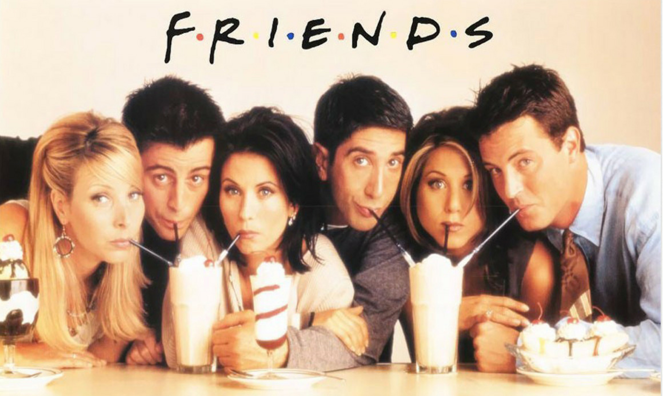
So no one told you life was gonna be this way…..
This line is from the theme song of a well known show called FRIENDS. A story in which it focuses on the life of 6 different people with a similar way of living who happen to be best friends. This show has 10 seasons in which I have watched every episode 2 or more times. I take this 90’s comedy to heart. Making references from lines or scenes have been something my friends have learned I do quite a lot.

Slide 4
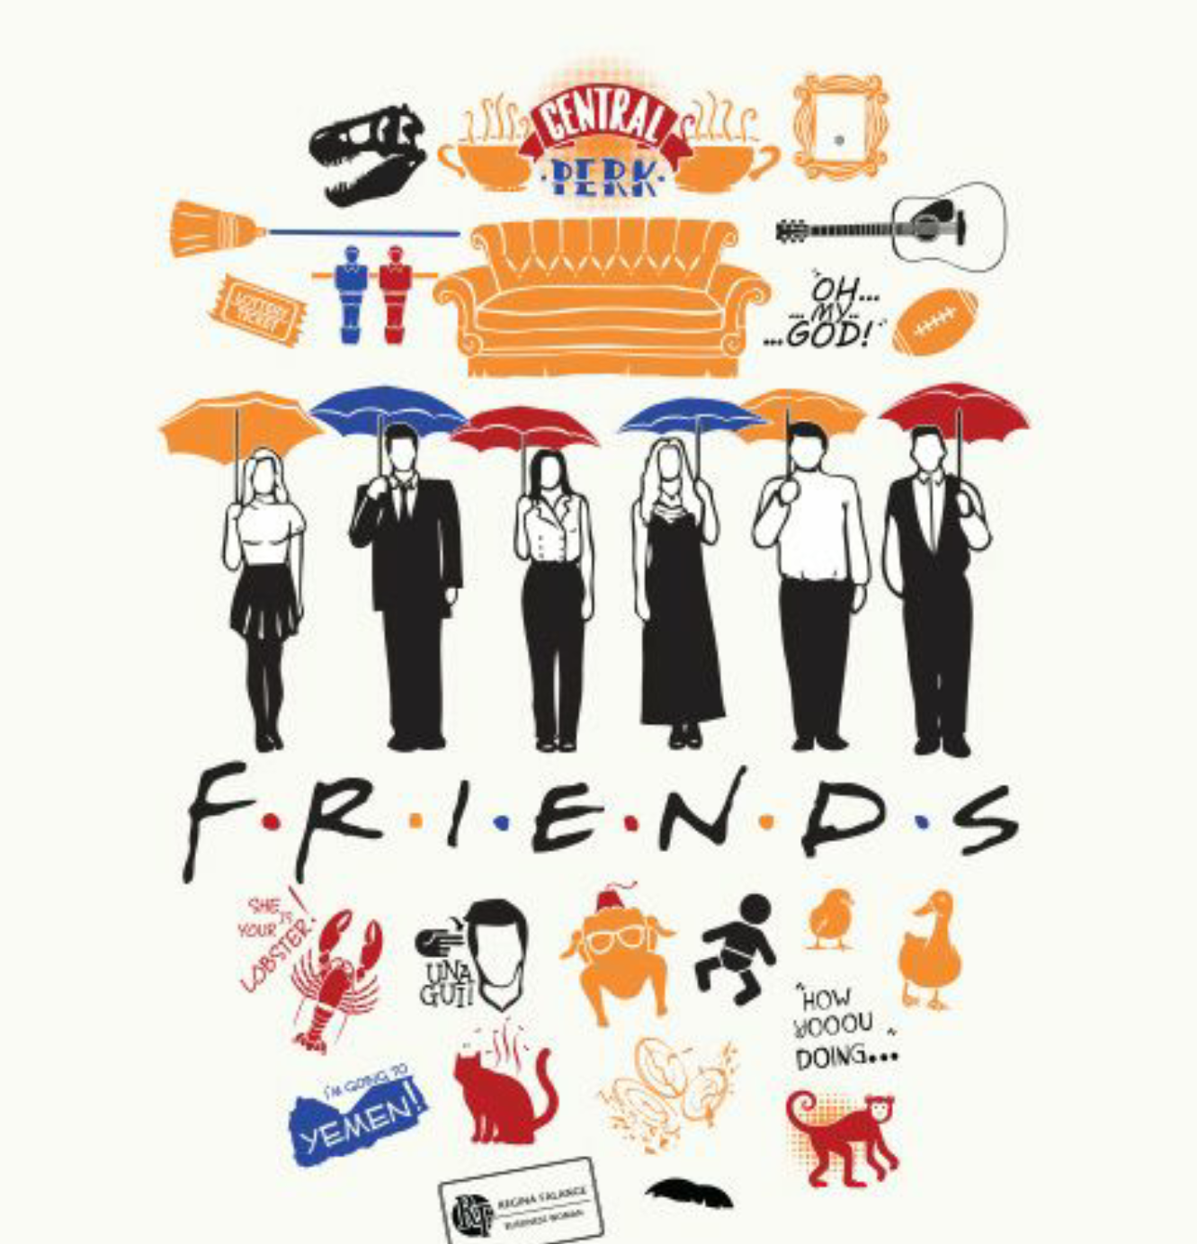
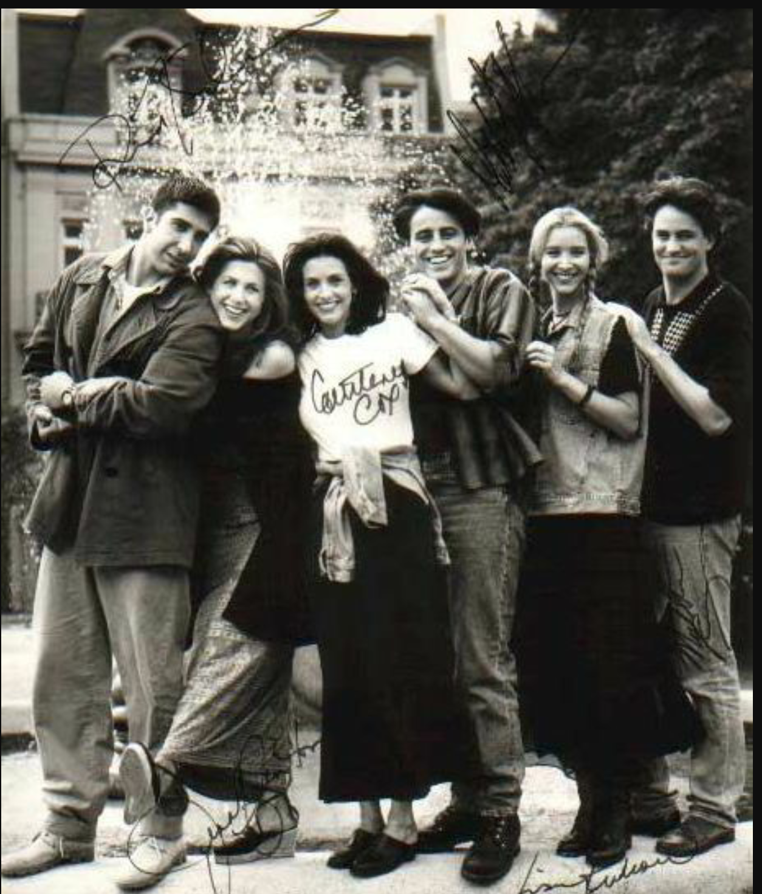
There is a reason for this ‘torture’ as one of my friends has put it. I have felt a change and improvement in myself. This simple show of a bunch of friends sitting in a coffee shop all day instead of being at work has taken me through an almost personal transformation. I mean, that reference I made in the last line probably doesn’t sound like a great thing I should follow, of course, but there are other more important lessons I’ve learned throughout the course of the show.

Slide 5
FRIENDS has taught me that living your life without technology can’t be that bad. Actually, I find when I put my phone down and the people I surround my life with do the same, we almost learn more from one another then through a small screen. The direct and emotional feeling between humans can be so strong and real. This show has taught me what real living and communicating it truly about.

Slide 6
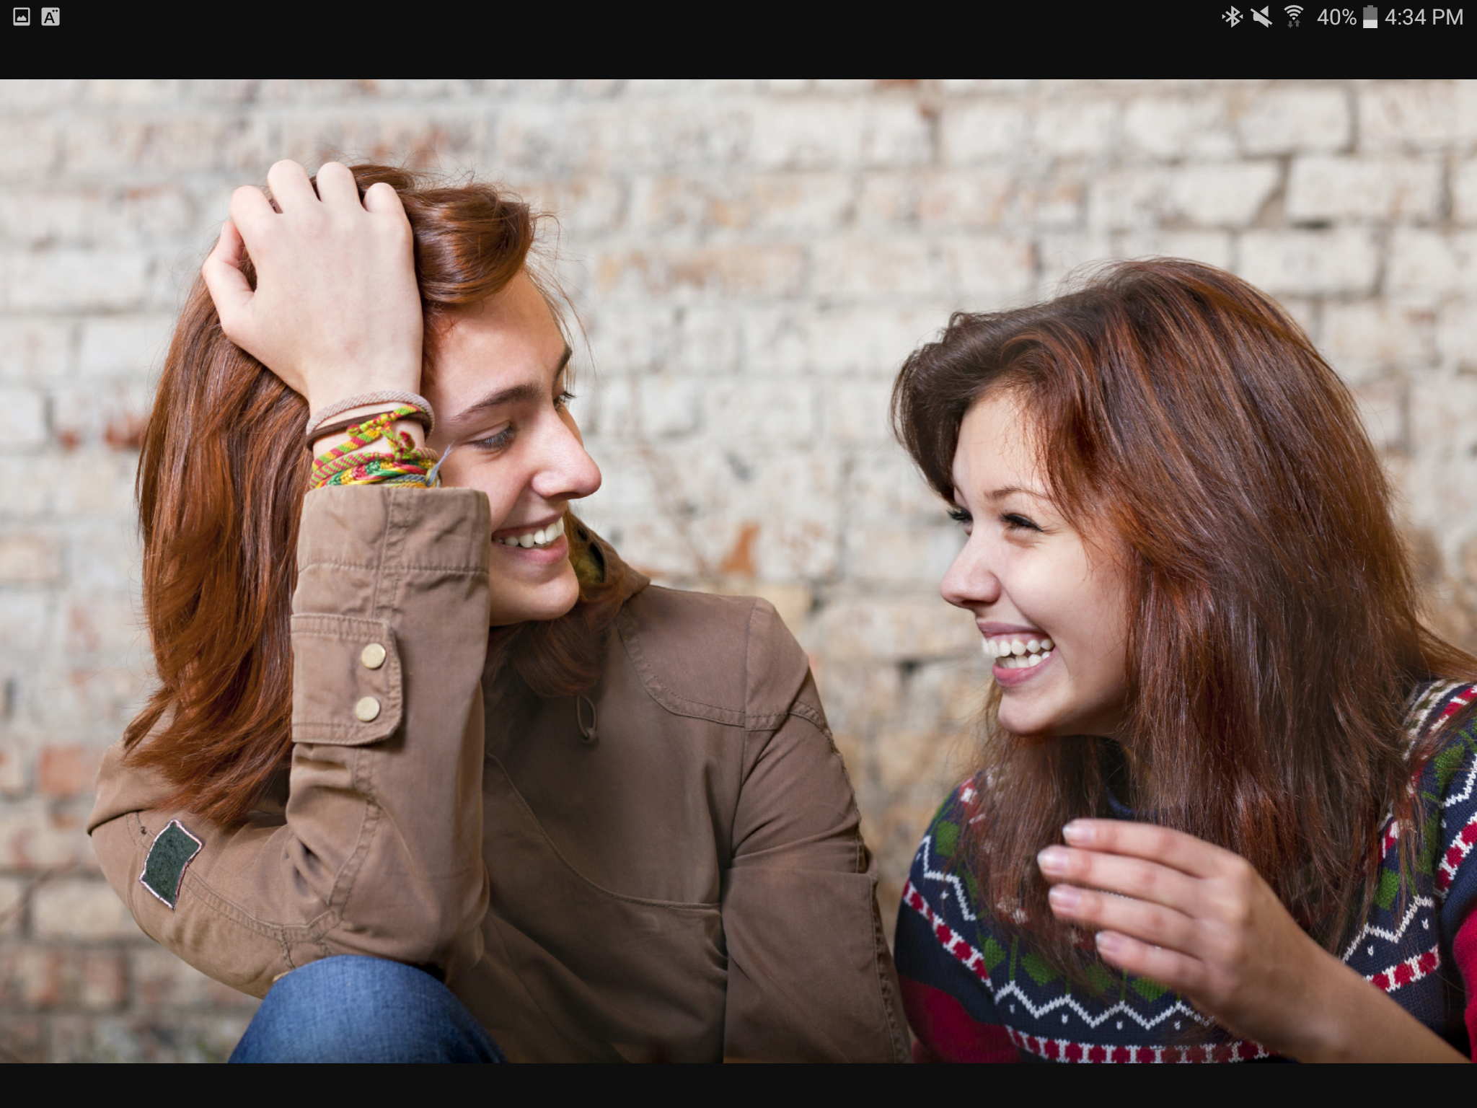
The sound of laughter just lightens my mood. Whether it’s my own or the recorded sounds of the laughter in the background of the show, I love that very sound. I notice things too. Some people or shall I say most people have more then one way of laugh. It depends on the situation at hand. Whether it’s when an awkward situation that had unfolded or a soft breath of extra air from watching that video on YouTube. Maybe it was from something your friend told you just a moment ago and you can’t look at this person any more or you will break out in that loud laughter once again. There is so many different ways of laughing and so many ways it makes me smile.

Slide 7
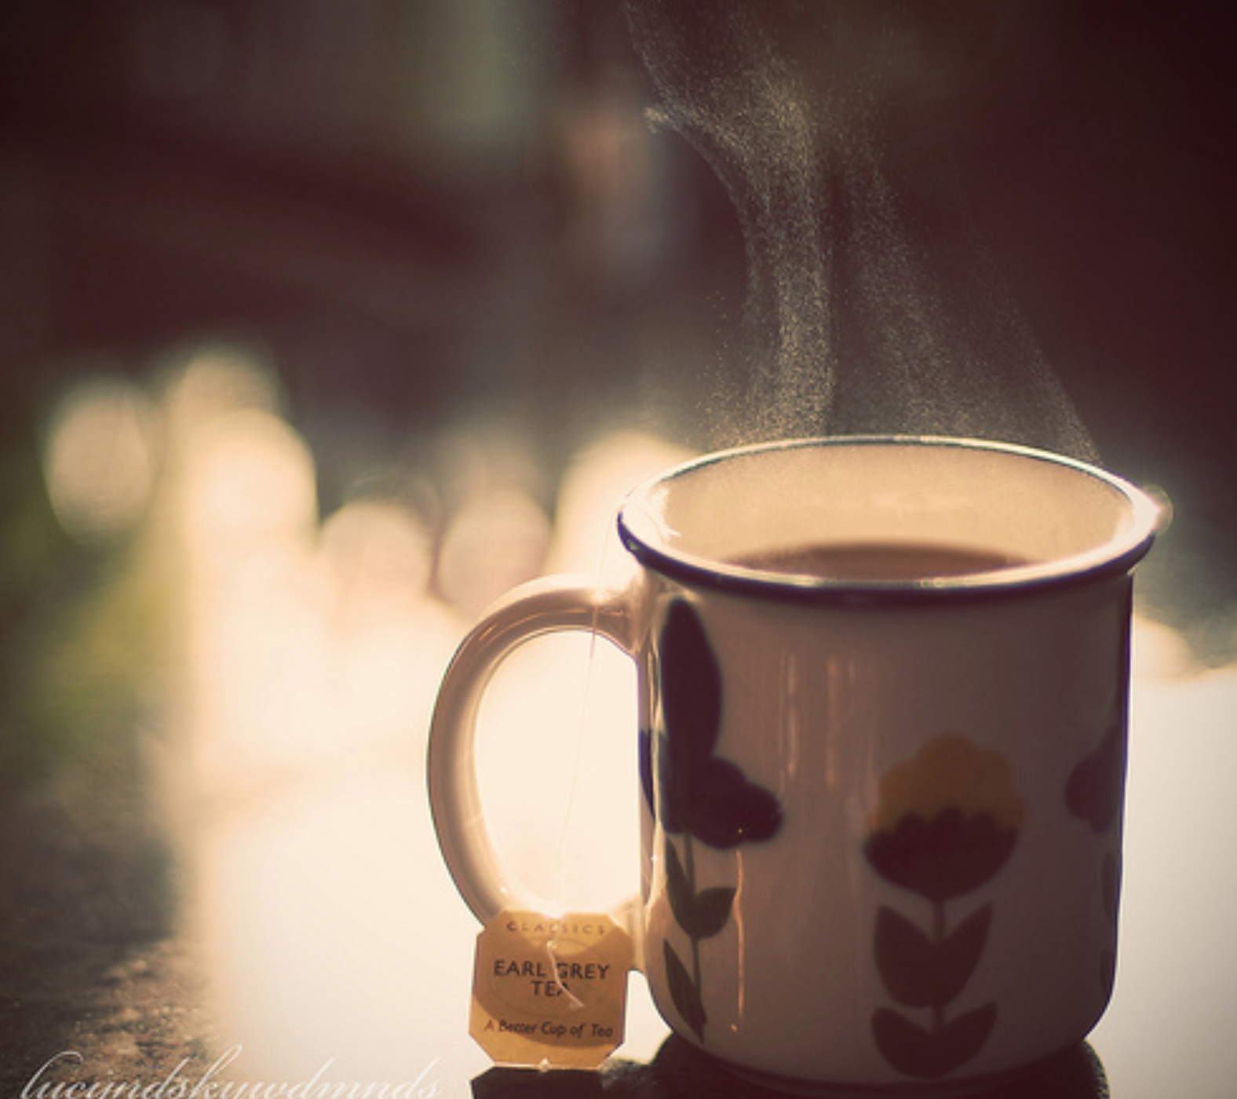
Tea. A thing I probably shouldn’t be drinking and could be a factor of my height… well at least that’s what I like to think. Anything to make my height someone’s or something else’s problem. With all joking aside friends has taught me how actually drinking and just the smell of tea can calm the mind.

Slide 8
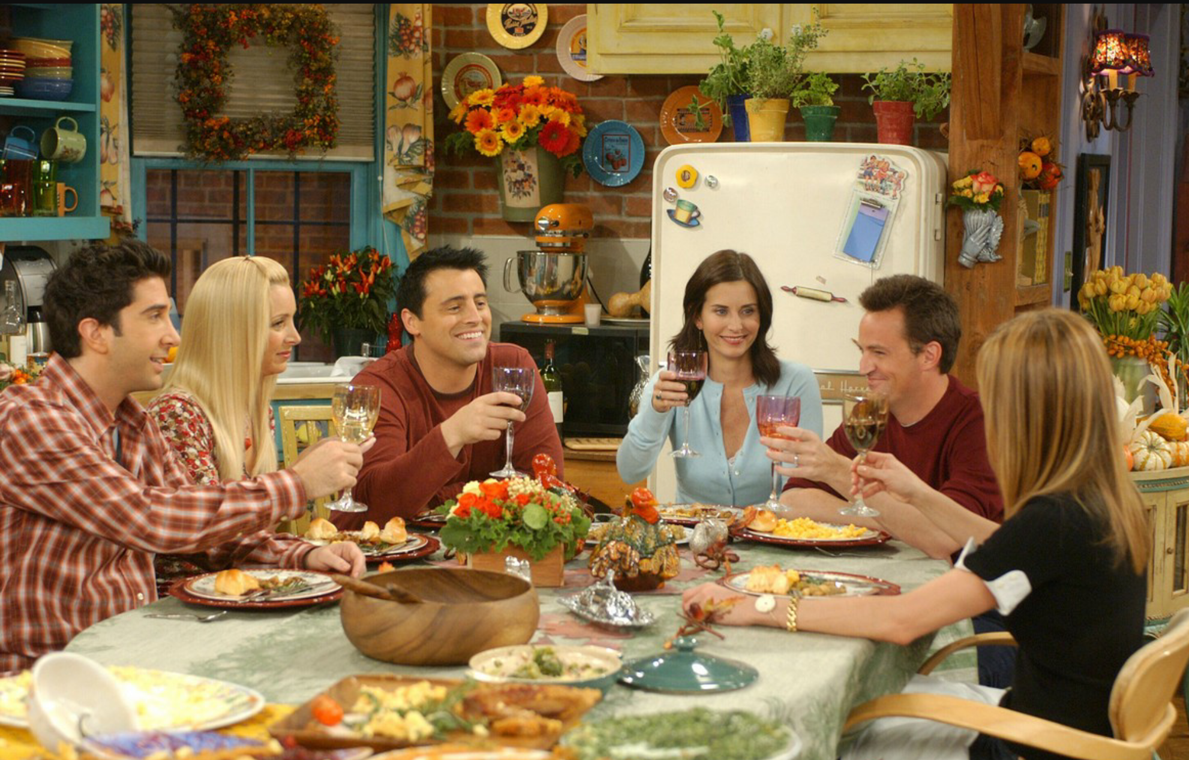
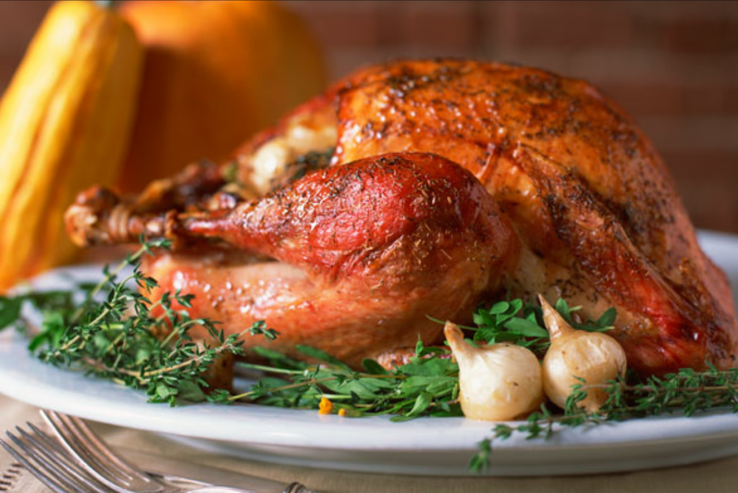
The very importance of Thanksgiving was enlightened after the 10 seasons. Okay more like 20 seasons because of watching it twice but what I mean is that every season Friends had a Thanksgiving episode. Throughout each Thanksgiving episode the characters growth and lifestyle has changed. Whether it was in a drastic way or only a minor one. The one thing that always was the same was the 6 of them were all there. Together like a family. Every time I go to my grandma’s for Thanksgiving dinner and eat that a little over cooked turkey; I think of those moments. When looking around I am searching for that change. That growth that people have in them internally.

Slide 9
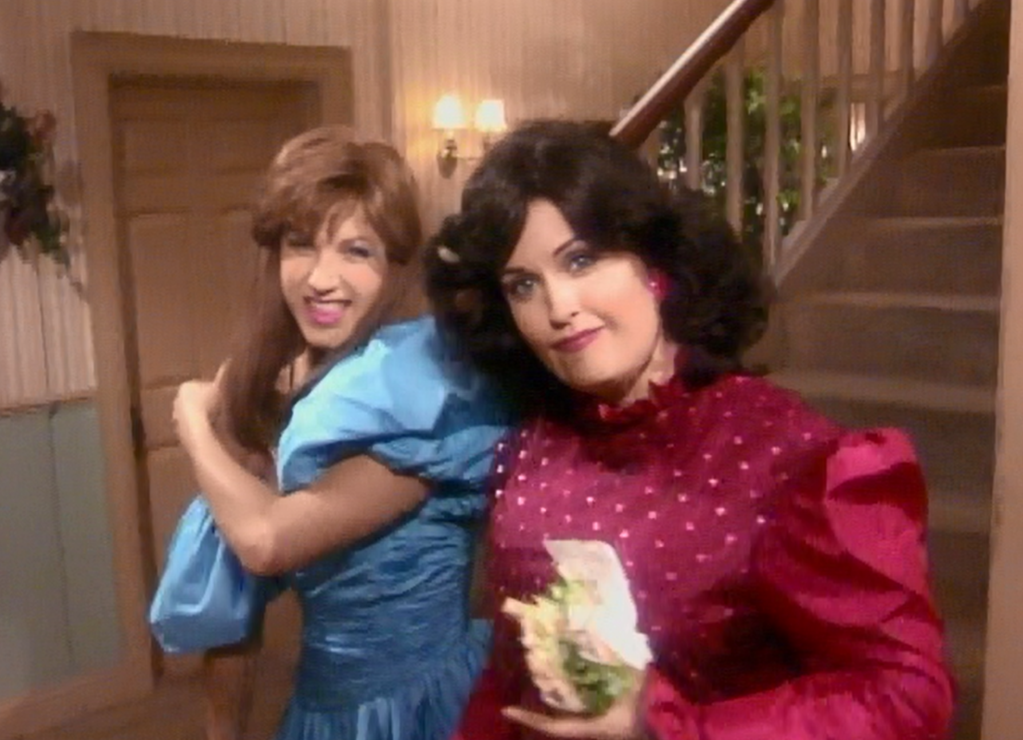
Friends has taught me one more important and truly valued rule to live by. My family is my family and cherishing them to ends of earth. But also love and respect the friends you have. The sight of my best friend makes me cry. She moved away last year and we get to see one another on rare occasions. But she’s still my best friend and I’m hers. When I see her I know I can tell her anything in the whole entire world and she wouldn’t judge or say a word to any soul. We are similar to Monica and Rachel. How those two stayed friends in high school surprised me when I first watched it. How could someone in that higher status of school be friends with someone is down in the dirt of statuses? But now I can see Cleary now. I understand.

Slide 10
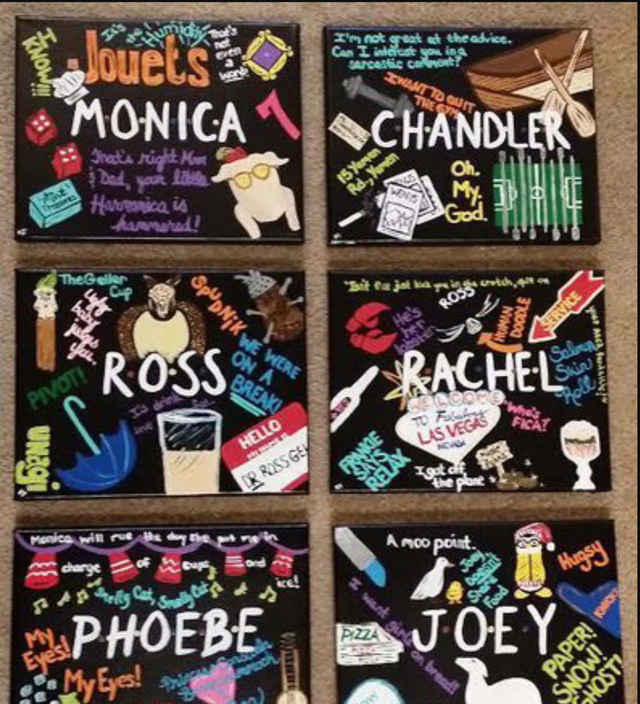
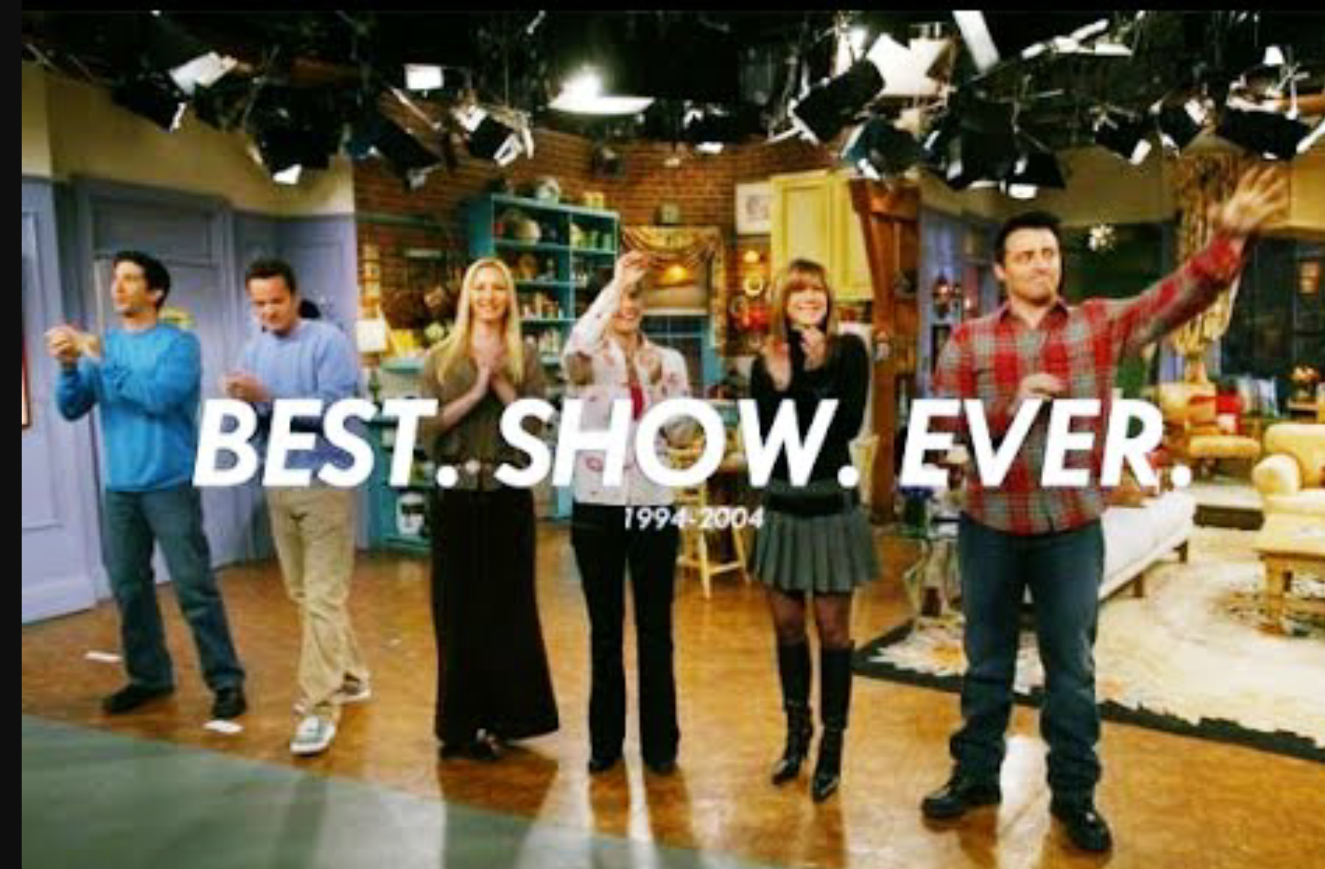
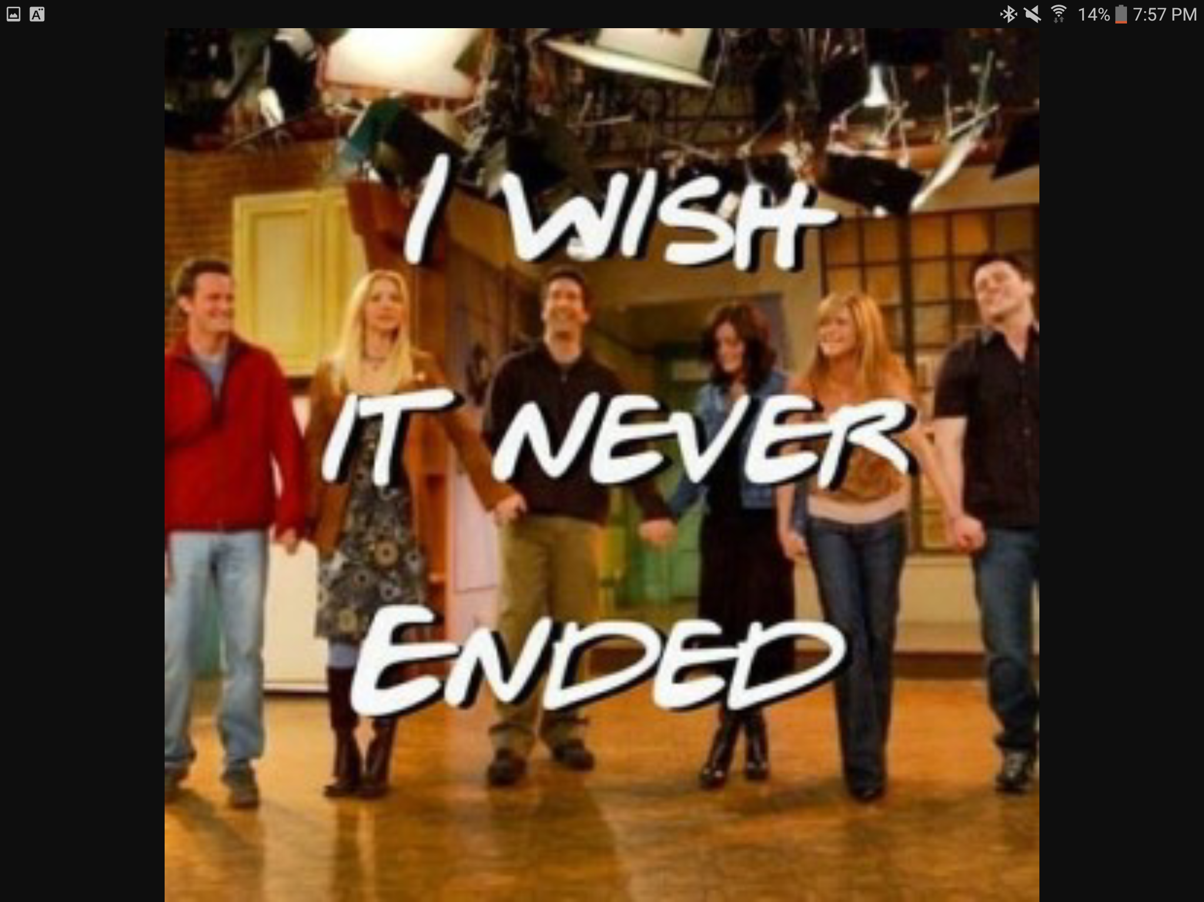
Life is full of experiences and mine maybe isn’t focused on some amazing event that took me through the adventure of a life time. I chose to do this in away that represented me and my experiences through a show which seems like it’s just a 90’s comedy. However that’s not the case. At least not for me. FRIENDS has made an impact on my life and I am extremely proud of how it has.

Slide 11
