Slide 1
Visual Safety Guide
By Ava M

Slide 2
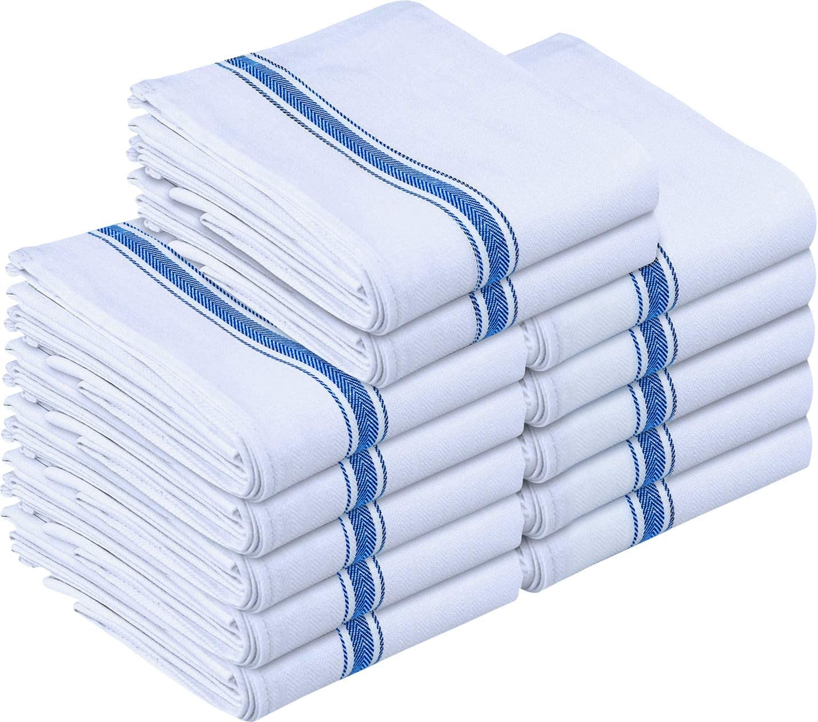
Fire
Don't leave recipes or tea towels near the stove.
Because they could catch on fire if you aren't careful.
Don’t leave food unattended while it is cooking.
Because it could burn which could cause a fire.

Slide 3
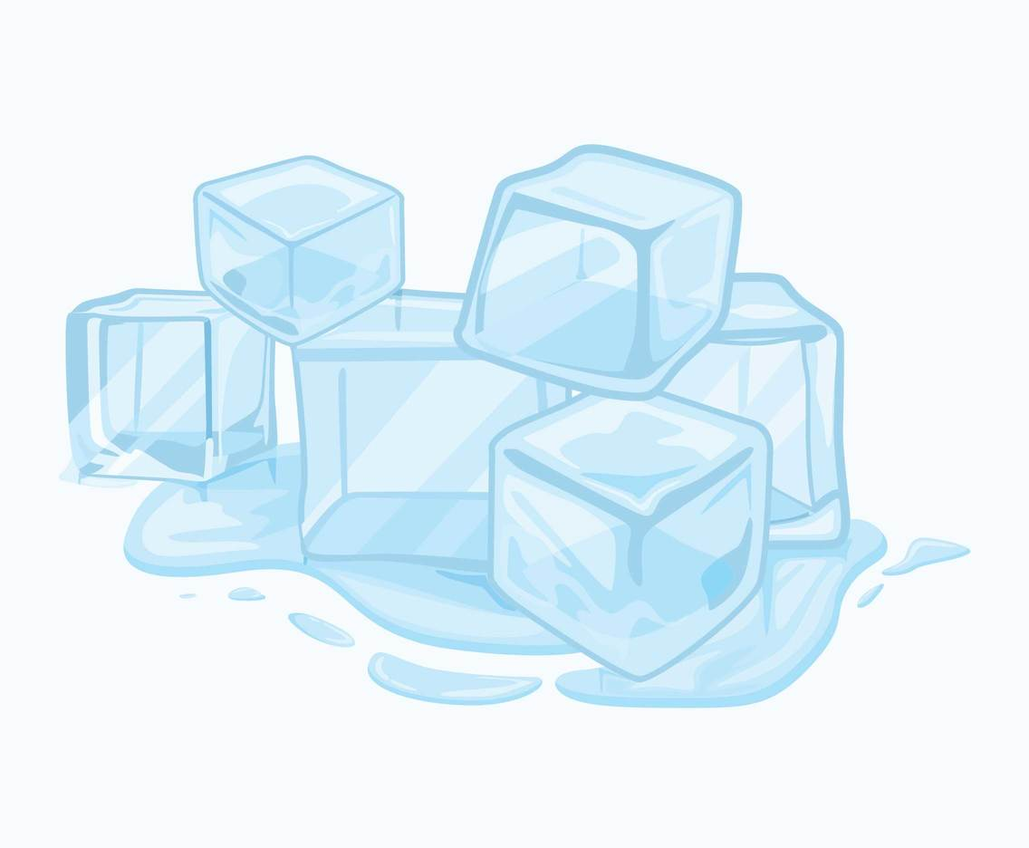
Burns and scalds
If you get a burn run it under cold water for 10 minutes. Because it will reduce the risk of blisters and scarring.
Never put ice on a burn.
Because it could cause more damage.

Slide 4
Chemicals
Never mix chemicals together.
Because you could cause chemical reactions or make new chemicals without knowing it.
Don’t store chemicals near food
Because they could contaminate the food.

Slide 5
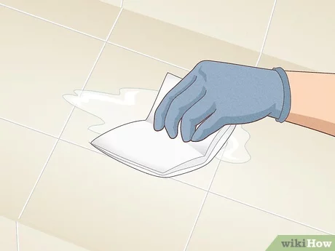
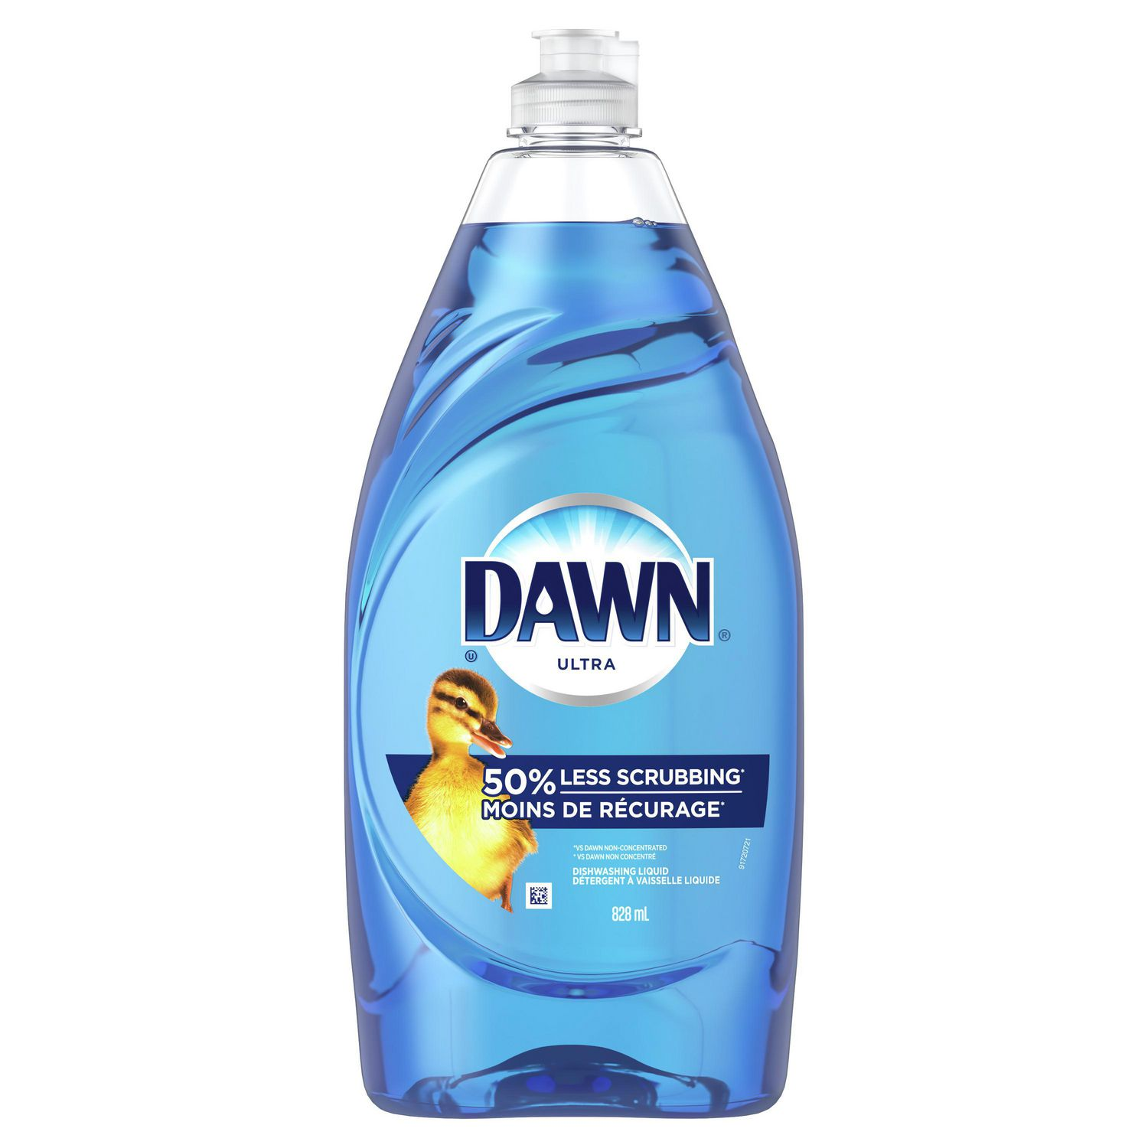
Slips, trips and falls
Wipe up any spills immediately.
Because someone could slip and fall.
If you spill oil use dish soap to clean it up.
Because water isn't enough to properly clean up oil.

Slide 6
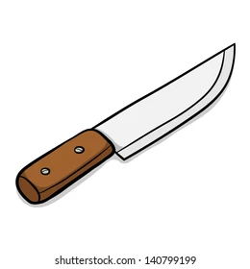
Cuts
Pick up broken glass with a wet paper towel.
Because if you touch broken glass with your bare hands, you could get a cut.
When washing dishes don’t leave sharp knives in the sink.
Because someone could put their hand in the water and unknowingly cut themselves.

Slide 7
Heavy lifting
If you are trying to lift something that says it is a two-person job, get someone to help you.
Because you could hurt your back or break the thing you are trying to move.
When lifting something use your knees for support.
Because it provides you with more stability and can prevent injuries.

Slide 8
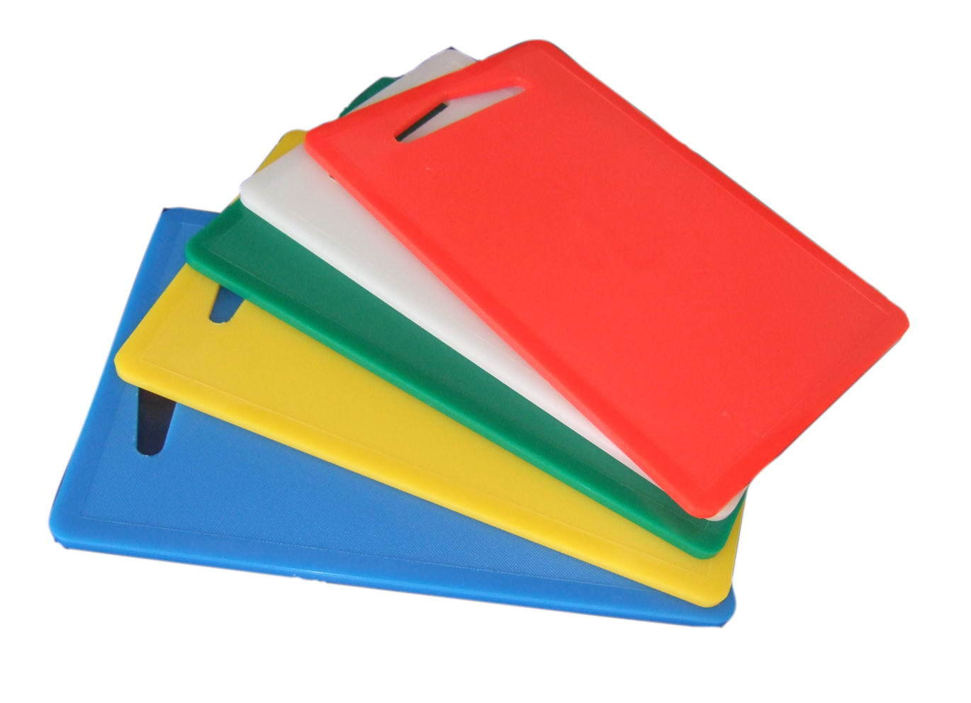
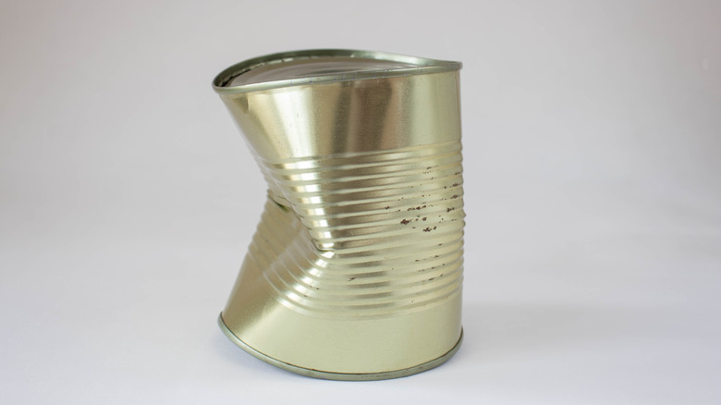
Food poising prevention
Make sure chicken and meat is prepared on a separate cutting board from vegetables.
Because this prevents cross contamination.
Don't eat anything from cans that are dented, bulging or leaking.
Because they could make you sick.

Slide 9
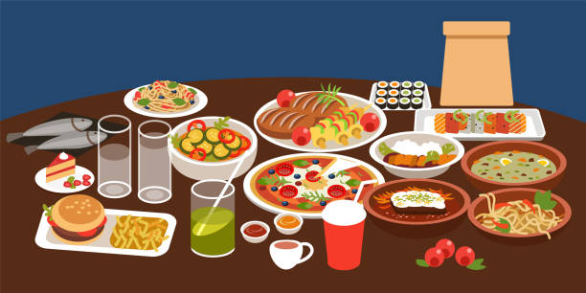
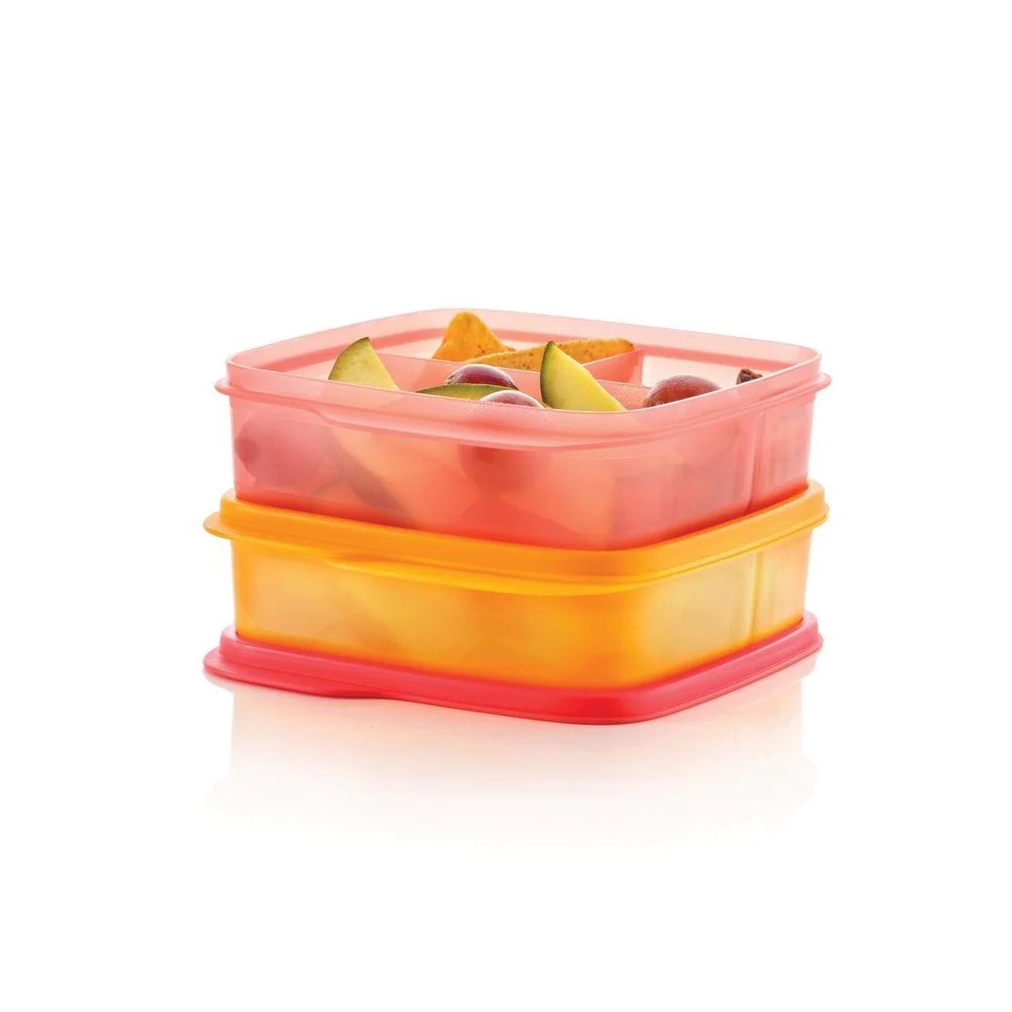
Waste management
Don’t buy or make more than what you are going to eat.
Because it might get thrown out and wasted.
If you do have leftover food, give it to someone else or put in a container to eat later.
Because it can be eaten later instead of it just being wasted.

Slide 10
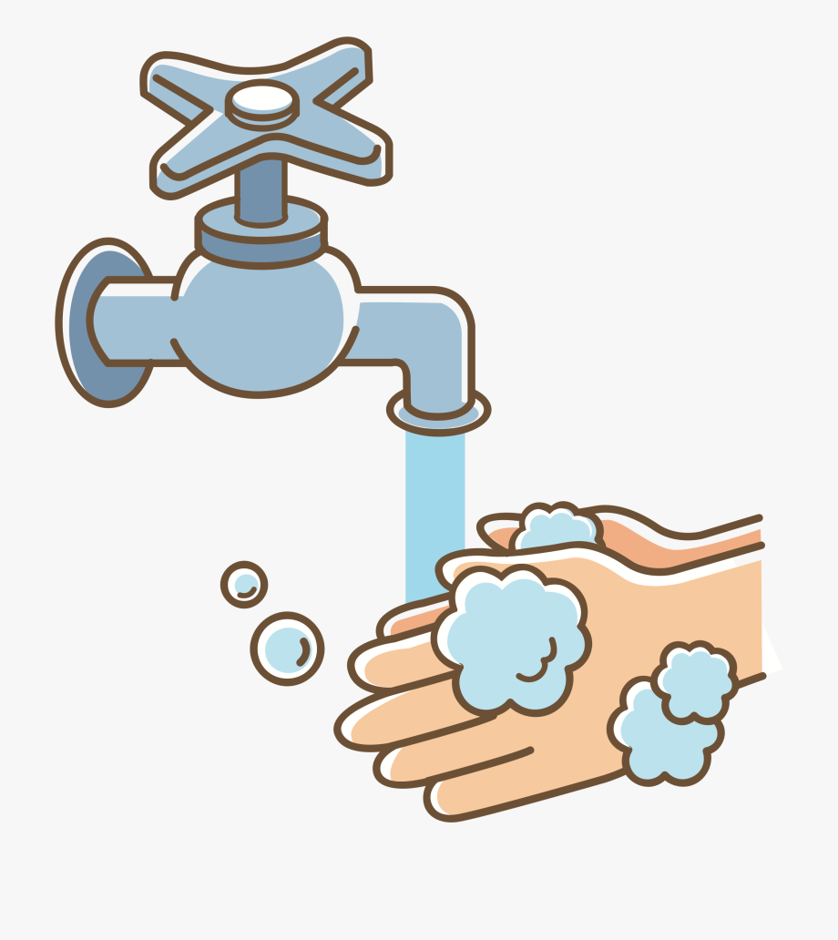
Personal Hygiene
Wash your hands frequently when cooking.
Because you don’t want to cross contaminate your food.
If you have long hair, put it in a ponytail before cooking.
Because hair could get into the food which is unsanitary.

Slide 11
Sources
https://m.media-amazon.com/images/I/714RzjnJxbL._AC_SL1431_.jpg
https://cdn1.vectorstock.com/i/1000x1000/56/85/woman-cooking-food-in-kitchen-cartoon-cook-vector-34255685.jpg
https://media.istockphoto.com/vectors/tap-with-running-water-jet-plumbing-in-kitchen-and-bathroom-flow-and-vector-id1333864744?k=20&m=1333864744&s=612x612&w=0&h=bL8O5Ocfml6AyIPchazUDA3V7oXYGs3g1QlYy2TIw40=
https://www.freevector.com/uploads/vector/preview/30443/Melting-Ice-Cubes-Clipart.jpg
https://www.pngitem.com/pimgs/m/267-2670893_chemicals-clipart-science-safety-clipart-hd-png-download.png
https://media.istockphoto.com/vectors/laboratory-beaker-icon-chemical-experiment-in-flask-hemistry-and-vector-id1165295700?k=20&m=1165295700&s=612x612&w=0&h=Nokqv3d9oNEdVTtqkG02vhxVZPVtXS31ZfZ1AQ6BTiY=
https://creazilla-store.fra1.digitaloceanspaces.com/emojis/57835/doughnut-emoji-clipart-md.png
https://www.wikihow.com/images/thumb/f/f0/Clean-Up-an-Isopropyl-Alcohol-Spill-Step-4.jpg/v4-460px-Clean-Up-an-Isopropyl-Alcohol-Spill-Step-4.jpg.webp
https://i5.walmartimages.ca/images/Enlarge/756/363/6000197756363.jpg
https://www.pngitem.com/pimgs/m/32-327405_broken-glass-clipart-broken-glass-shards-clipart-hd.png
https://image.shutterstock.com/image-vector/wooden-handle-knife-cartoon-vector-260nw-140799199.jpg
https://image.shutterstock.com/image-vector/two-person-heavy-lift-symbol-260nw-1352366108.jpg
https://t3.ftcdn.net/jpg/01/82/24/62/360_F_182246261_NM5uLX09bbwIkuUquV4E7xh2aUpY33hG.jpg

Slide 12
Sources
https://image.made-in-china.com/2f0j00iBFahtmICnzg/with-Handle-Rectangular-Plastic-Cutting-Board-with-Handle-Chopping-Board.jpg
https://www.mashed.com/img/gallery/is-it-safe-to-eat-food-from-a-dented-can/intro-1649335071.jpg
https://media.istockphoto.com/vectors/different-food-colorful-vector-illustration-in-flat-cartoon-style-vector-id1181590510?k=20&m=1181590510&s=612x612&w=0&h=uo6CdFsnSGsgV5SvWP-_65gnUZs38kngc4xvmYRId_0=
http://cdn.shopify.com/s/files/1/0566/5465/9761/products/x_33db32c5-214a-4b3f-88fd-5dda64924c98.png?v=1627591364
https://i.pinimg.com/originals/70/46/a8/7046a82c572c1c605c1dbb15b182655e.png
https://thumbs.dreamstime.com/b/woman-pony-tail-face-profile-vector-illustration-graphic-design-135238650.jpg

