Slide 1
Electrostatic Sandpaper
Project by: Jenna, Mara, and Morgan

Slide 2
Did you know that sandpaper isn’t actually made from sand? Or paper?
It’s made out of some sort of fabric, usually polly-cotton, and then the fabric is heated in order to apply grains onto it. It was invented in 1834 by Isaac Fischer Jr in the United States. Then in 1921, The Minnesota Mining and Manufacturing company (3M) invented sandpaper that had a wet backing. These were the first formal sandpaper inventions, but for years before that, workers would use paper with rice, grain, or even gum stuck on, to sand things down.

Slide 3
So how does it work?
Start with fabric, usually Polly-Cotton and move the fabric to rollers that apply information on the back. The fabric is taken below ground to a hot area called “the pit”, which is the perfect condition for applying grains electro-statically on the sandpaper. The grains are poured above onto a conveyor plate, which moves the grains underneath the fabric and below the electrodes and ground plates. This creates an electrical field and sets off a mini sand storm. Once airborne, the grains imbed themselves into the adhesive fabric. This electrostatic system allows them to evenly distribute the grains across the fabric.

Slide 4
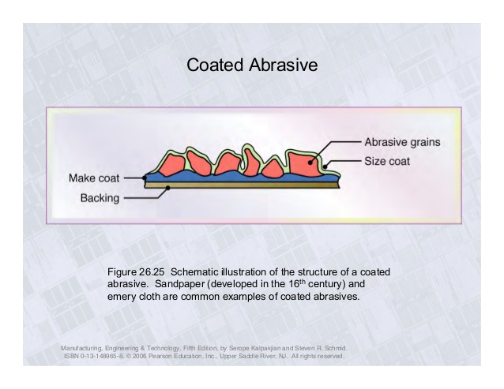
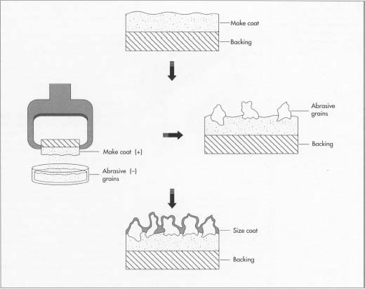
How It’s Made:

Slide 5
How Does Static Electricity Take Part in the Process?
The Static Electricity is used when the sandpaper is in “the pit”. Using sandpaper is also a form of static electricity. The cloth has an adhesive side to it, and it is placed down over a pan of abrasives that have been electrostatically charged. It has been given an electric charge opposite of the backing’s, so that it attracts and is evenly distrubted.

Slide 6
What’s the Purpose of Sandpaper?
Sandpaper is an abrasive object used for many things. These can include the sanding of wood or metal, cleaning of rust and/or making different types of artwork or enhancing artwork. It is mostly used in work shops but it can also be used in your own household. Sandpaper also comes in many different grits to suit your needs. Without it, all our wooden floors, cupboards etc. would be rough and uneven which would result in a lot more slivers. Which aren't fun at all. Metals wouldn't have those nice finishes on them and artwork would be less spectacular, because of these reasons, sandpaper is actually very important.

Slide 7
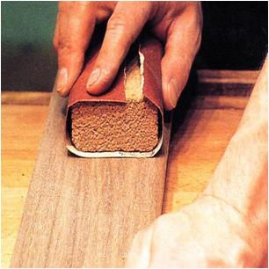
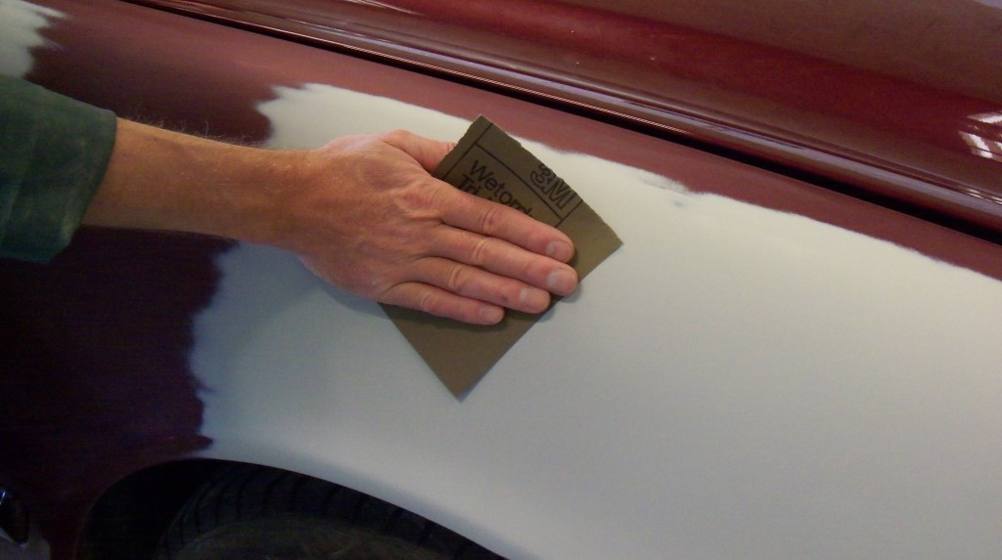
Sandpaper for Woodworking

Slide 8
PRIZES!
We’re going to ask some questions, whoever gets the question correct, will win a prize. Turn off your screens, please don’t look through the PowerPoint, you won’t get a candy if you do.
When was sandpaper created?
Where does static electricity come into play when creating sandpaper?
What is sand paper maninly used for?
What is usually sandpaper made of?
What is one thing that you learned from this presentation, that wasn’t in the questions.

Slide 9
Work Cited Page
http://www.abrasivesoasis.com/sandpaper.asp
https://www.youtube.com/watch?v=FpkRlFrlHy8
http://www.inspirationspaint.com.au/articles/details/abrasives-what-they-are-and-how-to-use-them
http://www.langstaffclassics.co.uk/general-car-body-repair-and-paintwork/14-primer-is-wet-flatted-using-a-fine-grade-sand-paper-to-ensure-a-smooth-flawless-surface-to-paint/

