Slide 1
Has British Columbia always been a multicultural & accepting province?
No, British Columbia was not always multicultural and accepting because we treated the other populations that isn’t British poorly.

Slide 2
Telegraphic message from Mr K.Ishie, at Vancouver BC, September 8th 1907
Having arrived at Vancouver at 11 pm the 7th of September I have found that during the early part of the evening there was held monstration of the Anti-Japanese and Korean league, and at about a number of rowdies, numbering from fifty to sixty, marched to the section of the city, where there are stores, kept by both the Japaneses and Chinese, throwing stones at them, breaking glasses. After there was another attack increasing the number to around 500, one Japanese was wounded.
This means that there are people that doesn’t like Japanese and wants to chase them away. Same thing happened with the Chinese with a riot on Chinatown.

Slide 3
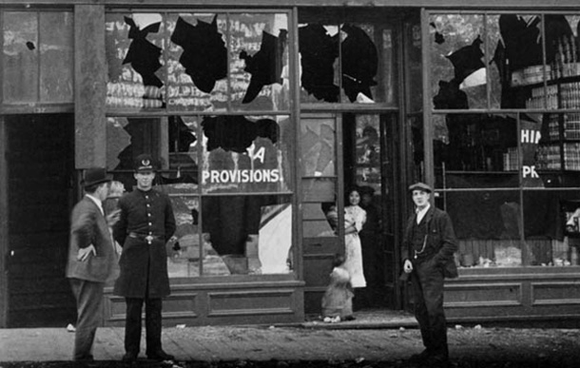

Slide 4
Chinese Immigration Act 1885
Every person of Chinese origin shall pay.. The sum of fifty dollars.
Every Chinese immigrant that came from China would have to pay fifty dollars to get in Canada. It shows how the British didn’t want Chinese immigrants.
Prime Minister Stephen Harper delivered a nation's regrets for "the racist actions of our past“. He apologized on June 22nd, 2006 for the head tax.

Slide 5
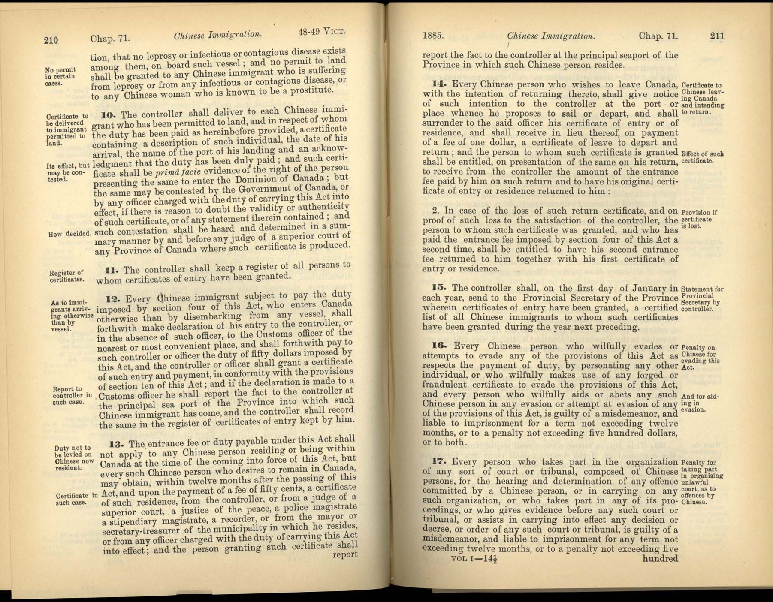

Slide 6
Order-in-Council PC 1911-1324, 12 August 1911
For a period of one year from and after the date hereof the landing in Canada shall be and the same is prohibited of any immigrants belonging to the Negro race, which race is deemed unsuitable to the climate and requirements of Canada.
The government created a law where Canada prohibited black immigrants coming to Canada. The law said the race would have a hard time living in Canada due to the climate and requirements.

Slide 7
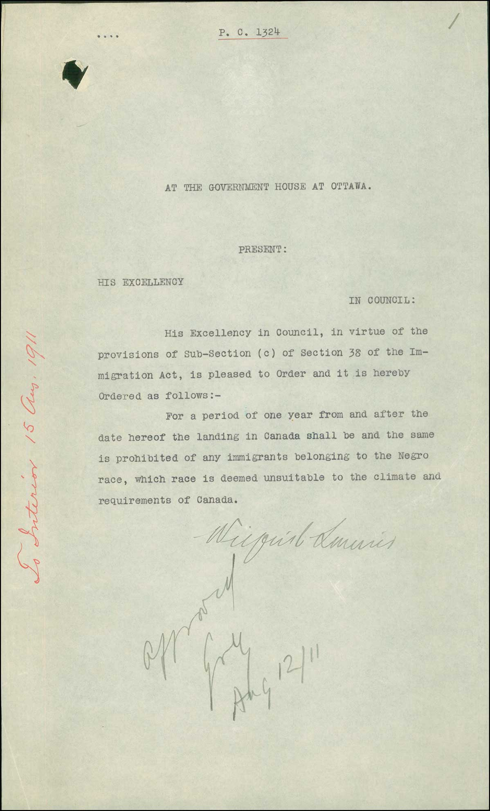

Slide 8
Canadian Jewish Archives Volume 1, Ch, 2nd of the Prayers
The fixed prayers shall further be read in the Hebrew Language according to the custom of the Spanish and Portuguese Jews and no other—
Canadian law forced the Jewish to abandon their religion, the law is made so the Jewish cannot pray in Hebrew Language but read in English.

Slide 9
Websites
https://tc2.ca/sourcedocs/history-docs/topics/chinese-canadian-history/government-response-to-the-1907-riots.html
https://tc2.ca/sourcedocs/history-docs/topics/chinese-canadian-history/reasons-for-the-head-tax.html
http://www.thecanadianencyclopedia.ca/en/article/order-in-council-pc-1911-1324-the-proposed-ban-on-black-immigration-to-canada/
https://www.cjarchives.ca/media/12527/cja-v01n01.pdf

Slide 10
The End
British Columbia wasn’t always multicultural and accepting.

