Slide 1
Tire Pressure Monitoring Systems (TPMS)

Slide 2
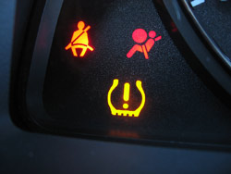
Why have TPMS?
tire pressure issues = 23,000 accidents and over 500 deaths annually
correct tire PSI = would save 15 million liters of fuel per day (in North America)
27% of cars and 33% of light trucks have one or more tires substantially under-inflated
Does this vehicle have a TPMS?
Notes:
TPMS isn’t mandated in Canada, but an estimated 70 per cent of vehicles sold since 2007 are equipped with TPMS.

Slide 3
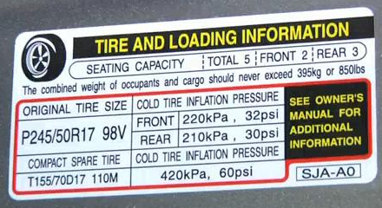
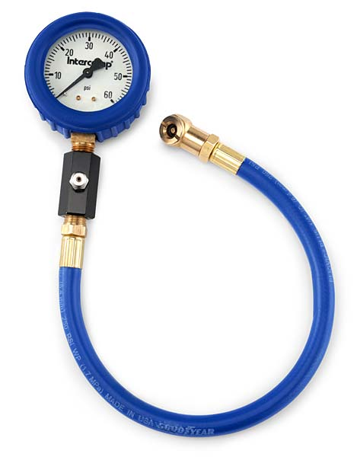
Tire Pressure Adjustment
set tires to factory specifications listed on door decal…
use a high quality pressure gauge
Note: may need to drive 35 km/h to turn off light after adjustment
Notes:
Different front and rear specs require relearn after rotation.
Temperature affects tire pressure (sensors also read temp)
Factory TPMS systems are not adjustable for different PSI

Slide 4
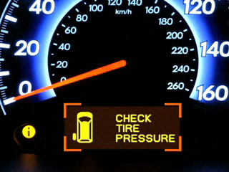
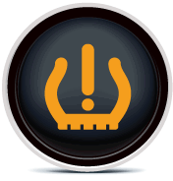
Tire Pressure Monitoring
designed to continually monitor tires for low tire pressure
should detect any tire under inflated by 25%
uses a driver warning light

Slide 5
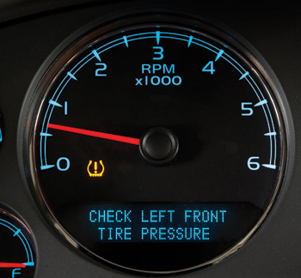
TPMS Designs
Industry uses two different systems
Indirect – Low Tire Warning System (LTW)
Direct – Tire Pressure Monitoring System (TPMS)
Notes:
Indirect uses ABS wheel speed sensors to detect low tire pressure (because tire psi affects circumference of tire therefore tire RPM)
Unfortunately, indirect tire pressure monitoring systems have several shortcomings.
Indirect systems won't tell the drivers which tire is low on pressure, and won't warn the driver if all four tires are losing pressure at the same rate
(as occurs during the fall and winter months when ambient temperatures get colder).
Additionally, our current experience with indirect systems indicates that they can generate frequent false warnings.
Direct is most common and best systems and it measures tire pressure with wheel mounted sensors.

Slide 6
Indirect LTW
Does not measure actual air pressure
ABS wheel sensors compare tire RPM
How does tire pressure affect wheel RPM?
P225/75R15
Radius @ 32 psi = 35.8 cm
Circumference = 2.25 m
Speed at 100kph = 741 rpm
P225/75R15
Radius @ 25 psi = 33.9 cm
Circumference = 2.13 m
Speed at 100kph = 782 rpm
Notes:
These systems are cheaper in design but may have more false alarms.

Slide 7
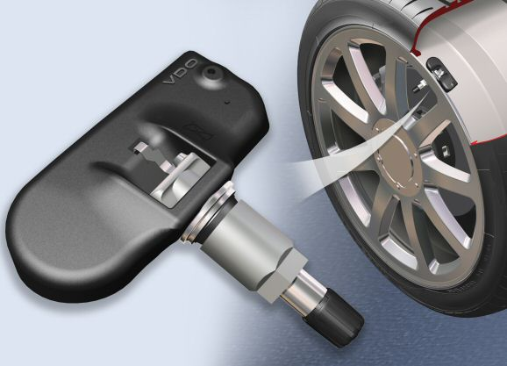
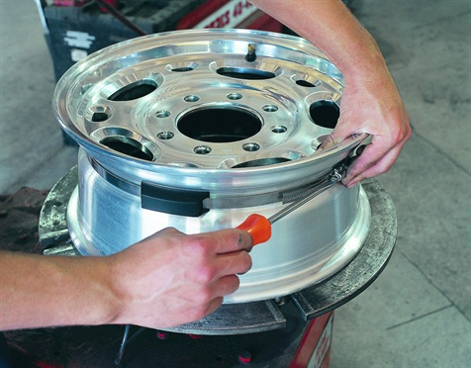
Direct TPMS
utilizes:
an air pressure transmitter in each wheel
a receiver module
a low tire pressure warning light

Slide 8
Direct TPMS
Receiver module
each wheel pressure sensor has a unique transmitter ID

Slide 9
TPMS Indicator Light
Three Modes of Operation
prove-out
on for 3 seconds when key turned
solid
on all the time when low tire pressure detected
flash then solid
fault in TPMS detected
Notes:
Message center equipped vehicles will provide more information, such as tire location

Slide 10
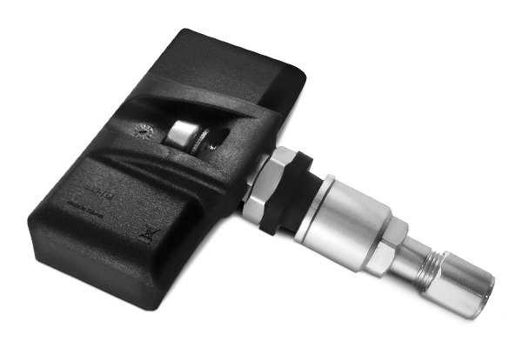
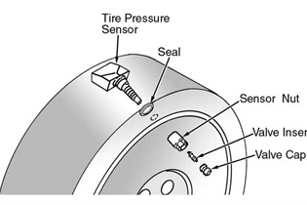
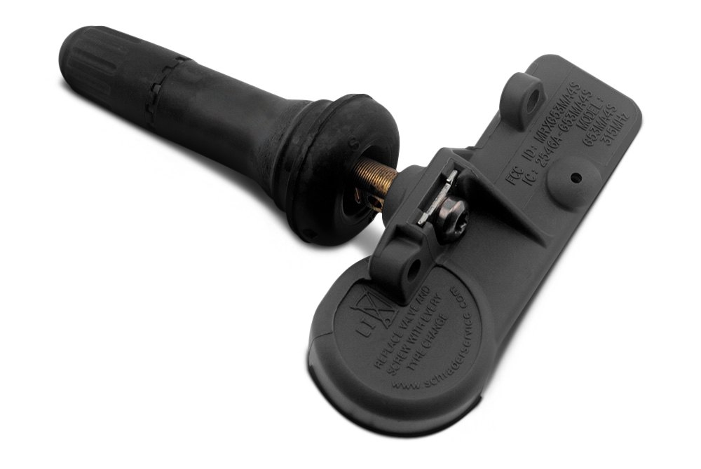
Valve Stem Transmitter
Bolt-on stem-mounted sensor; must use:
nickel plated stem
aluminum or plastic cap
Rubber valve stem mounted sensor
sensor serviced separately from stem
Notes:
Notice brass shoulder identifying TPMS on rubber stem

Slide 11
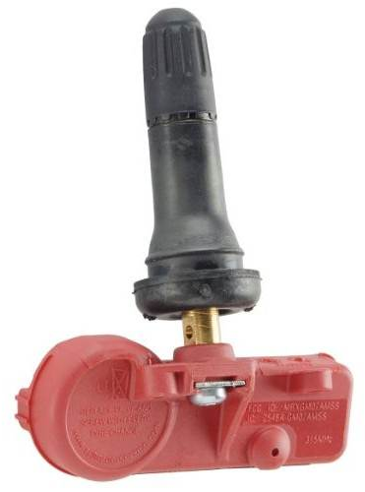
TPMS Sensor Battery
All TPMS Sensors use Lithium Ion Batteries
not replaceable – sensor replacement required
designed to last 5-10 years

Slide 12
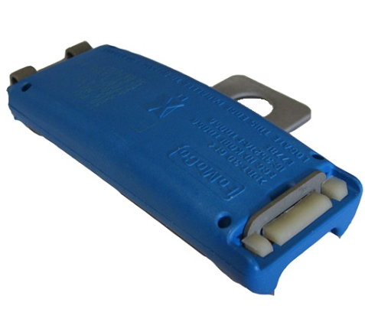
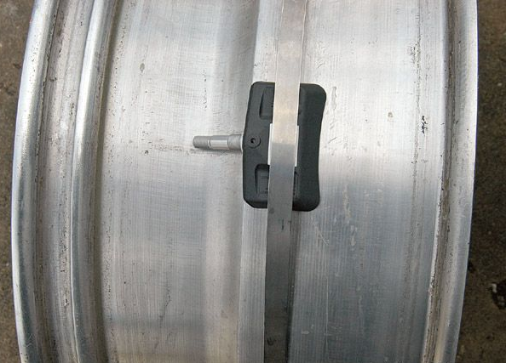
Band-Mounted Transmitter
mounted 180° from valve stem
Notes:
Sensors have been known to shift and through off wheel balance.
Always verify sensor location with scan tool before dismounting tire.
Double sided adhesive tape between sensor band and rim reduces shifting

Slide 13
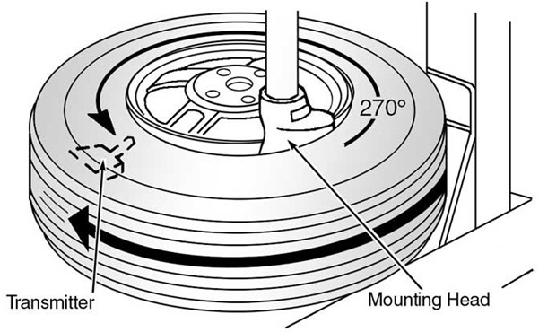
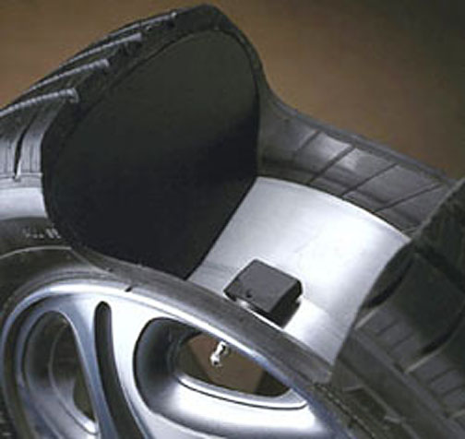
Demounting
care must be taken when de-mounting tires
recommend demounting - begin 90° from sensor
avoid removing valve cores and stem assemblies
Notes:
Recommend replacing stem core if removed and if sensor is removed you will need to reseal with a service kit.

Slide 14
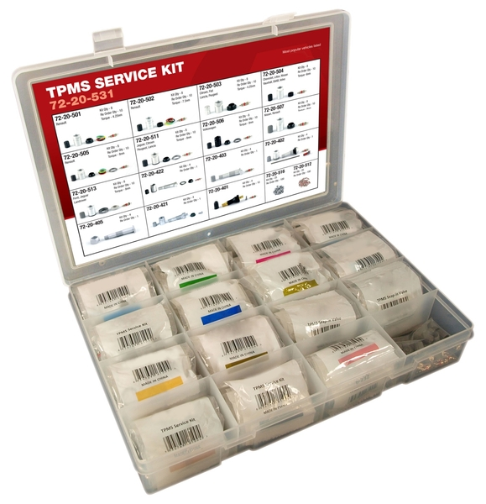
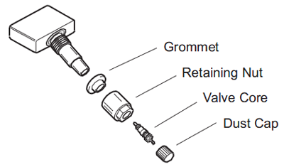
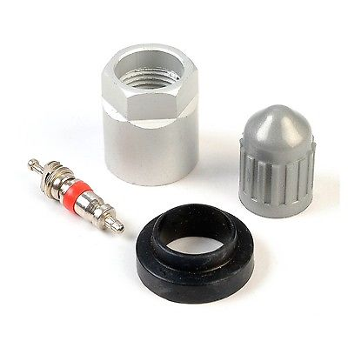
Sensor Service
each time a tire is repaired or replaced:
replacement of grommet, retaining nut, valve core & valve cap is recommended
this service kit costs approximately $7.00 each

Slide 15
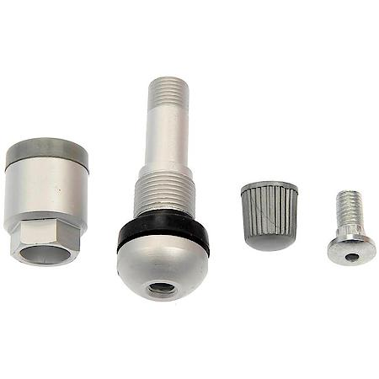
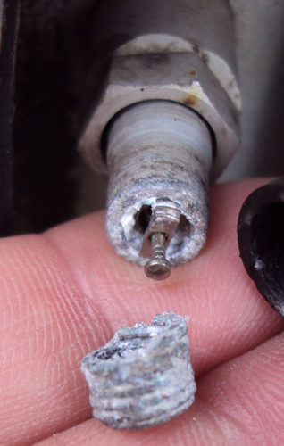
Sensor Service – corroded valves
if the valve assembly is corroded, a new one can be fitted…

Slide 16
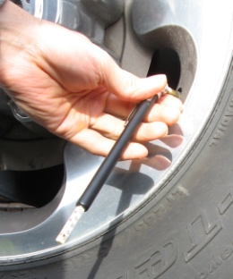
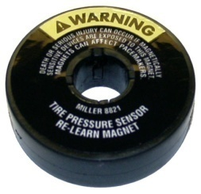
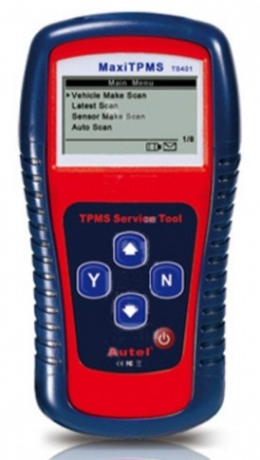
Direct System Servicing
Each transmitter is specific for each wheel.
Relearn is required when…
tire locations are changed
rims are replaced
sensors are replaced
Relearn procedure will vary - common procedures are:
pressure method
magnet method
diagnostic tool method
Notes:
*Note that reprogramming is only required when the vehicle uses a read out display that identifies true wheel location. Example LR tire low

Slide 17
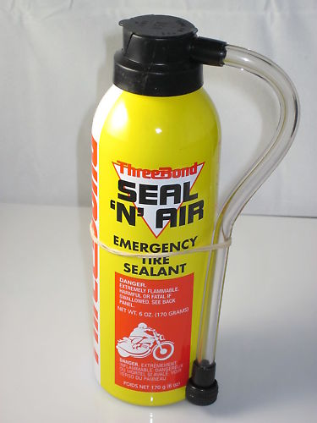
Cautions
Must use nickel plated stem core & correct valve stem cap.
dissimilar metals = corrosion
stem acts as an antenna
Never use tire sealant!
most tire aerosol sealant products warn never to use on TPMS equipped vehicles

Slide 18
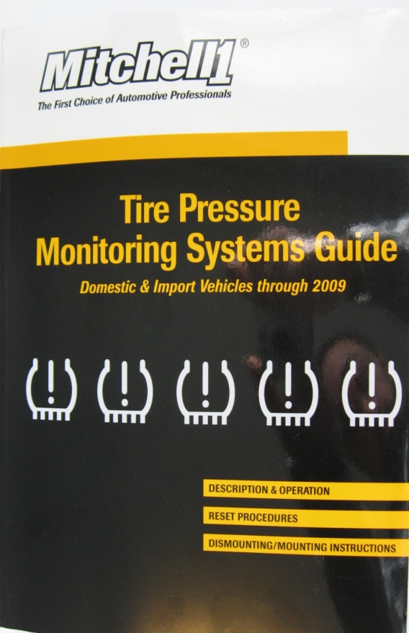
TPMS Tools – Service Information
TPMS differences from make, model & year?
Up to date service information is required!
Description & Operation
Sensor Identification
Relearn Procedure
Mounting Procedure
Sensor Torque Specifications
Notes:
Michell Manuals do not contain Diagnostic info and wiring diagrams but Motor Manuals do

Slide 19
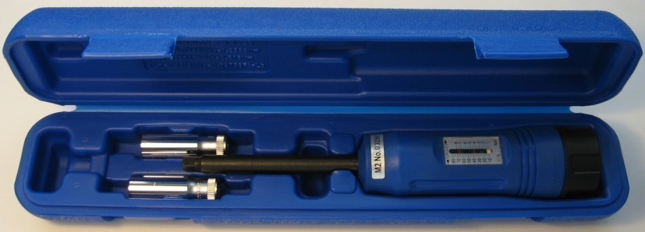
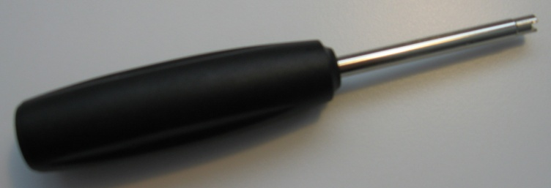
TPMS Tools – Torque Tools
to reduce the sensor's mass and keep the wheel in balance, the metal stem of the sender is commonly made of aluminum.
Use a torque wrench on the inch-pound scale to tighten these, because it's really easy to strip the threads by overtightening.
Ferrous-metal valve caps may interfere with the electronics, so stick with OEM-style plastic valve-stem caps.
TPMS Stem Installer
TPMS Valve Nut Driver

Slide 20
TPMS Diagnosis
What is the first step in TPMS Diagnosis?
verify tire pressure
What would be the next logical step?
try to read sensor data with activation tool.
How do you know if the vehicle is TPMS equipped?
TPMS indicator on dash when key cycled
Once initial inspection has been completed, further diagnosis may include scan tool and pinpoint diagnostic steps.

Slide 21
TPMS Diagnosis – RFI Interference
Poor module ground or alternator/ignition can cause RFI
Aftermarket accessories that can cause external RFI:
FM and CB radio transmitters
cell phone
AC - DC inverters
video equipment
alarm systems
electric motors
Notes:
Question the customer about accessories they use and when the fault occurs.

Slide 22
TPMS Diagnosis Tips
check for system or sensor faults
try known good sensors
rotate wheels – to see if problem follows sensor
check for stored events in memory
Notes:
Codes that indicate sensor faults will set if 3 or less sensors are detected by Module, System Fault = no sensors detected and likely a module issue.
If a sensor can not be detected, try holding an known good sensor in the proximity of the wheel and attempt relearn again.
Use scan tool to view “Events” Ford captures 5 events and these can be helpful in diagnosis. An Event is an occasion when the TPMS light came on. Note that tire location may not be correct if system was not relearned after rotate.

Slide 23
Review #1
Why have TPMS?
What is the TREAD Act?
What is different between Direct and Indirect TPMS?
What does a TPMS sensor do?
What is “Relearn”?
What are some ways of performing Relearn?
What are some important concerns when servicing with TPMS?
Notes:
Hand out this page as a worksheet, have the students do individually then form groups to compare answers. Finally review as a class.

Slide 24
Review #2
Describe the tire mounting procedure for band style and stem style TPMS sensors.
What can you perform with a TPMS activation tool?
What steps would you follow to perform a TPMS diagnosis?
What was the most important new information you learned today?
What do you look forward to learning more about?
Notes:
Hand out this page as a worksheet, have the students do individually then form groups to compare answers. Finally review as a class.
TREAD = Transportation Recall Enhancement Accountability & Documentation

